Slide 1

Data as a Signal Data X: A Course on Data, Signals, and Systems
Data ^{X}
About Me:
Ikhlaq Sidhu Chief Scientist & Founding Director, Sutardja Center for Entrepreneurship & Technology IEOR Emerging Area Professor Award, UC Berkeley

Slide 2
Outline for Data as a Signal Part I
A Framework
Data as a signal
Means, variances, and windows in time
Linear Time Invariant System Overview (LTI)
Convolution
Filter Examples: Finite Impulse Response, Infinite Impulse Response
Putting it together with a framework and prediction example

Slide 3
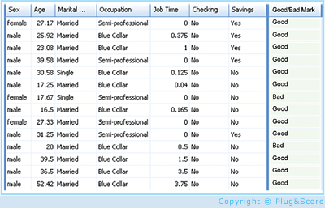
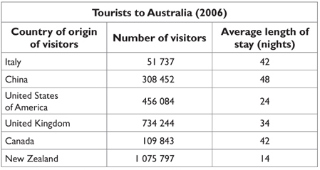
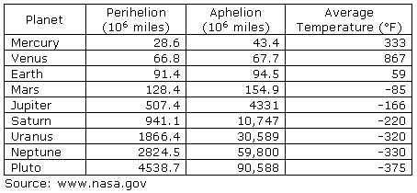
A High Level Framework
Features, but also loss of information
Some data has observed results
In Real Life
Objects
Events/Experiments
People/Customers
Products
Stocks
…
Person 1
Person 2
Person 3
.
.
.
Person N
In Sample
Out of Sample
Characteristics
Patterns
Models
Predictions
Similarities
Differences
Distance

Slide 4
Converting From Time Sequence Data to Features
Of course, not all data has a time property, but lets start with this type.
For example( key1, value 1),( key 2, value 2)… in this case, the keys are indexed by time.

Slide 5
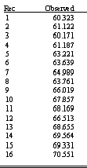
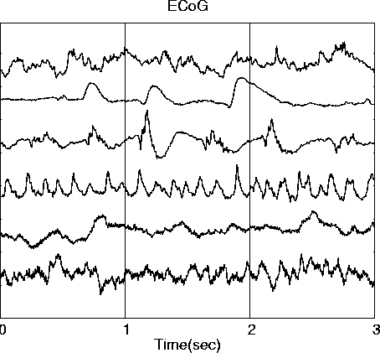
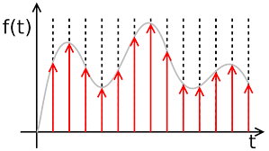
Converting From Time Sequence Data to Features
Many Types of data are signals in time
Stock market
Temperature
Instrument readings
Sometimes we sample them, record at intervals of T
We get a
list in a table, array, or vector
What we want (for now): features and characteristics
For example:
Means
Variances
Patten matches
Changes
accumulation
Frequency
Discrete data
x_{n} = x1, x2, x3, …
Continuous signals
x(t)
Sampled signals (data)
x(nT)
(might lose time reference)

Slide 6
Converting From Time Sequence Data to Features
Many Types of data are signals in time
Stock market
Temperature
Instrument readings
Sometimes we sample them, record at intervals of T
We get a
list in a table, array, or vector
What we want (for now): features and characteristics
For example:
Means
Variances
Patten matches
Changes
accumulation
Frequency
Discrete data
x_{n} = x1, x2, x3, …
Continuous signals
x(t)
Sampled signals (data)
x(nT)
(might lose time reference)

Slide 7
Converting From Time Sequence Data to Features
Many Types of data are signals in time
Stock market
Temperature
Instrument readings
Sometimes we sample them, record at intervals of T
We get a
list in a table, array, or vector
What we want (for now): features and characteristics
For example:
Means
Variances
Patten matches
Changes
accumulation
Frequency
Discrete data
x_{n} = x1, x2, x3, …
Continuous signals
x(t)
Sampled signals (data)
x(nT)
(might lose time reference)

Slide 8
Converting From Time Sequence Data to Features
Many Types of data are signals in time
Stock market
Temperature
Instrument readings
Sometimes we sample them, record at intervals of T
We get a
list in a table, array, or vector
What we want (for now): features and characteristics
For example:
Means
Variances
Patten matches
Changes
accumulation
Frequency
But from when, and over what time period
Discrete data
x_{n} = x1, x2, x3, …
Continuous signals
x(t)
Sampled signals (data)
x(nT)
(might lose time reference)

Slide 9
Approaches to the Data Sequences in Tables
Predictions or classifications on
A, B, C
Discrete data for each source A, B, C..
x_{n} = x1, x2, x3, …
Each row is a source: A, B, C..
Columns are features
u st.
A: f1, f2, f3, …
B: f1, f2, f3, …
C: f1, f2, f3, …
D: f1, f2, f3, …
f1 f2 f3
f1 1 .3 -.2
f2 -2 1 .4
f3 0 -.6 1
One row for each source
A, B, C, D..
Eg Numpy arrays
A: x1, x2, x3, …
B: x1, x2, x3, …
C: x1, x2, x3, …
D: x1, x2, x3, …
Correlation of features over all sources
Filters,
functions,
convolution..
Each row is a time
columns are features
Predictions or classifications on
Time 1, 2, 3 ..
A
x1
x2
x3
.
.
B
x1
x2
x3
.
.
C
x1
x2
x3
.
.
1
2
3
.
.
1: f1, f2, f3, …
2: f1, f2, f3, …
3: f1, f2, f3, …
4: f1, f2, f3, …
One column
for each series:
A , B, C, D..
eg Pandas
(add rows with every new time sample)
Correlation of sources
over a time period
A B C
A 1 .3 -.2
B -2 1 .4
C 0 -.6 1

Slide 10
Covariance and Correlation of Multiple Signals Data X: A Course on Data, Signals, and Systems
Data ^{X}
About Me:
Ikhlaq Sidhu Chief Scientist & Founding Director, Sutardja Center for Entrepreneurship & Technology IEOR Emerging Area Professor Award, UC Berkeley

Slide 11
Correlation and Covariance

Slide 12
Correlation and Covariance
Properties

Slide 13
Covariance: Alternative Format

Slide 14
Correlation Matrix
Table
Window W
x1 x2 … xn
Samples
1
2
3
4
5
6
W
.
.
.
x1
Samples from Window of W
x2
xn
Many samples, or a sequence in time
x1(t), x2(t), .. xn(t)
To estimate from data:
Use all samples ever collected
Use window size of W samples of each to estimate a recent Corr Matrix

Slide 15
Correlation Matrix
Corr(x1,x1) = 1
Corr(x2, x1)
= E[ XY – E[X]E[y] ] / stdev(x) stdev(y)
You could even do this by hand:
Corr(x1,x1) ……..
Corr(x1,xn)
Corr(xn,x1)
x1 x2 E[x1 x2] E[x1] E[x2]
1 2 2 1.5 2.5 2 4 1 1 2 3
Corr(xn,xn)
To estimate from data:
Use all samples ever collected
Use window size of W samples of each to estimate recent Corr Matrix

Slide 16
Code Examples: Correlation of Rows with NumPy
Import numpy as np
x = [[0.1, .32, .2, 0.4, 0.8],
[.23, .18, .56, .61, .12],
[.9, .3, .6, .5, .3],
[.34, .75, .91, .19, .21]]
np.corrcoef(x)
Out[4]: array([
[ 1. , -0.35153114, -0.74736506, -0.48917666],
[-0.35153114, 1. , 0.23810227, 0.15958285],
[-0.74736506, 0.23810227, 1. , -0.03960706],
[-0.48917666, 0.15958285, -0.03960706, 1. ]
])
Here each row is a vector of length 5
There are 4 vectors
Correlation matrix is 4 x
If you want the correlation of the columns,
just use
np.corrcoef ( np.transpose(x) )
For a window, use a slice:
window = x[0:4,3:5] for the last
two columns

Slide 17
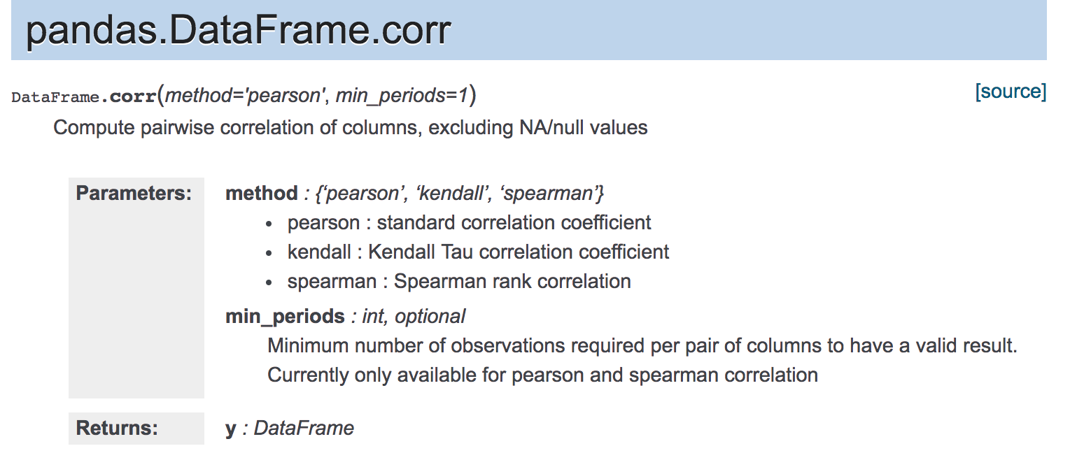
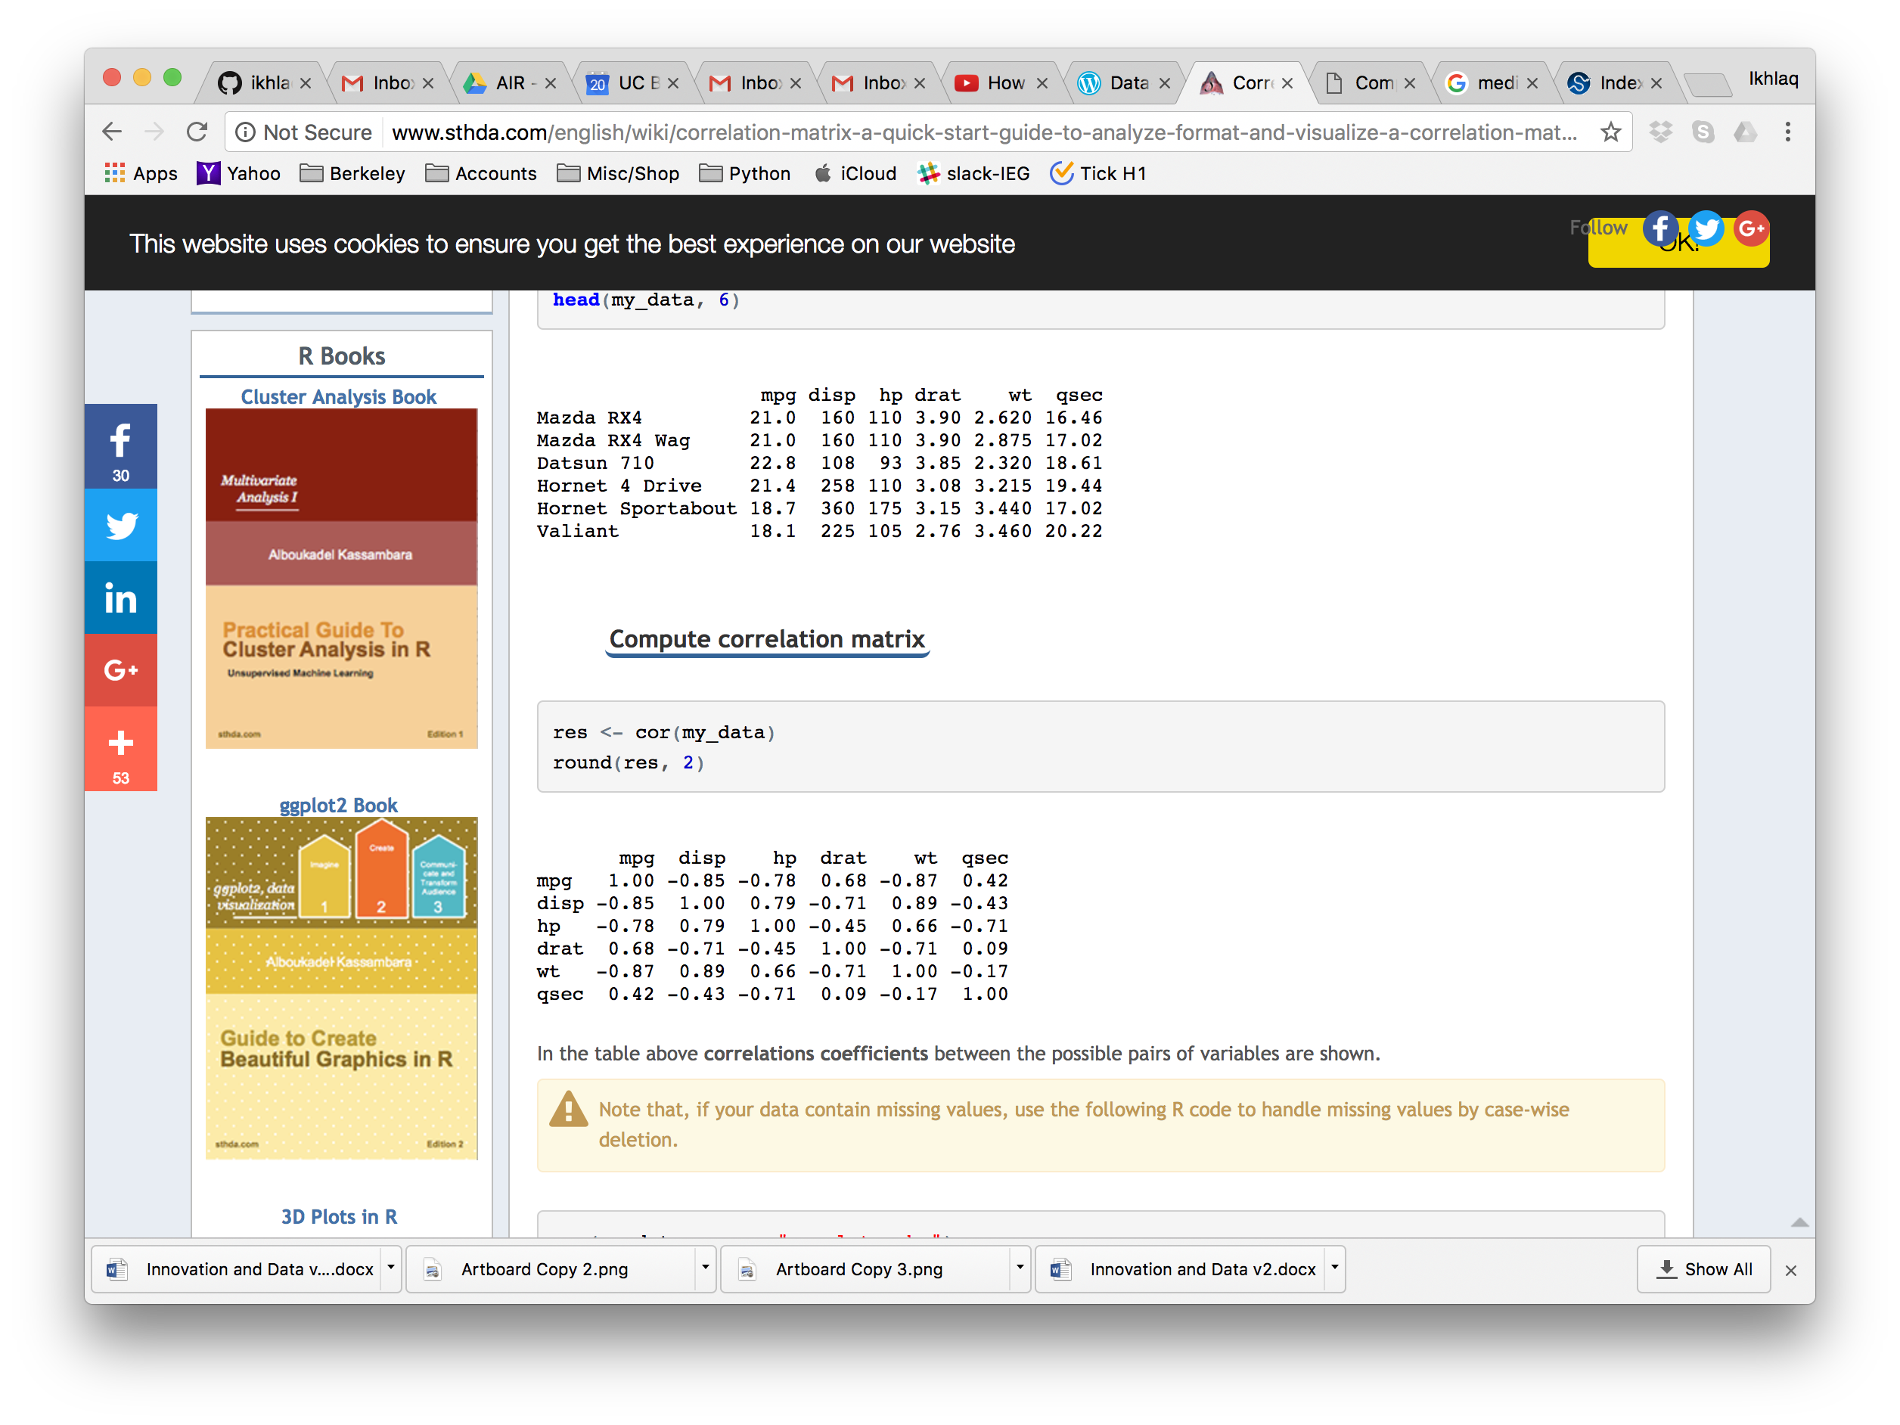
Correlation of Features from Different Sources
Pandas Table
Use corr()

Slide 18
Pandas will create a correlation matrix with “columns”

Slide 19
Approaches to the Data Sequences in Tables
Predictions or classifications on
A, B, C
Discrete data for each source A, B, C..
x_{n} = x1, x2, x3, …
Each row is a source: A, B, C..
Columns are features
u st.
A: f1, f2, f3, …
B: f1, f2, f3, …
C: f1, f2, f3, …
D: f1, f2, f3, …
f1 f2 f3
f1 1 .3 -.2
f2 -2 1 .4
f3 0 -.6 1
One row for each source
A, B, C, D..
Eg Numpy arrays
A: x1, x2, x3, …
B: x1, x2, x3, …
C: x1, x2, x3, …
D: x1, x2, x3, …
Correlation of features over all sources
Filters,
functions,
convolution..
Each row is a time
columns are features
Predictions or classifications on
Time 1, 2, 3 ..
A
x1
x2
x3
.
.
B
x1
x2
x3
.
.
C
x1
x2
x3
.
.
1
2
3
.
.
1: f1, f2, f3, …
2: f1, f2, f3, …
3: f1, f2, f3, …
4: f1, f2, f3, …
One column
for each series:
A , B, C, D..
eg Pandas
(add rows with every new time sample)
Correlation of sources
over a time period
A B C
A 1 .3 -.2
B -2 1 .4
C 0 -.6 1

Slide 20
Properties of Correlation

Slide 21
Properties of Correlation

Slide 22
Properties of Correlation

Slide 23
More Conversions from Real Time Data
Single Signals (an array)
Fourier Tansform: DTFT and FFT -> features that have spectral information
Pattern Matching -> feature = does the pattern exist, or how strongly
More types of scoring: mapping a vector to a single number
Multiple Inputs (multiple arrays or a matrix)
Cross correlation matrix
Jacobian Matrix – What is causing the most change?

Slide 25
End of Section

